Slide 1

Public safety for Bus

Slide 2


Bus position side view

Slide 3


Bus front and back view

Slide 4
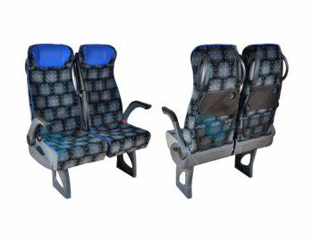
Bus front and seat position

Slide 5
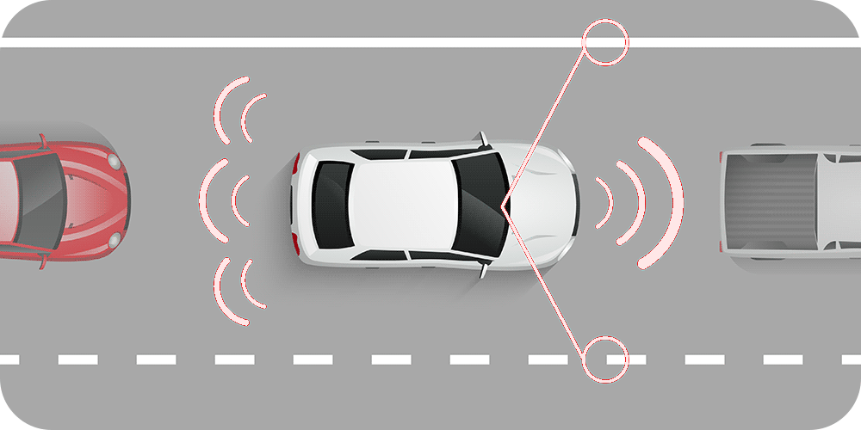
This method will be use in the bus:

Slide 6
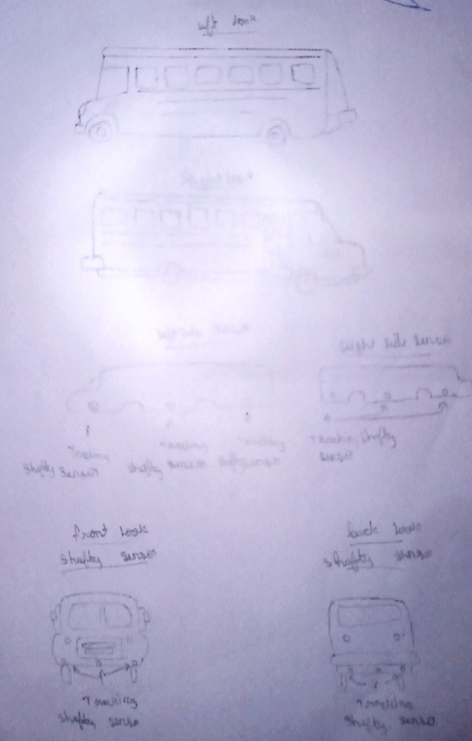
Bus shafety sensor image

Slide 7
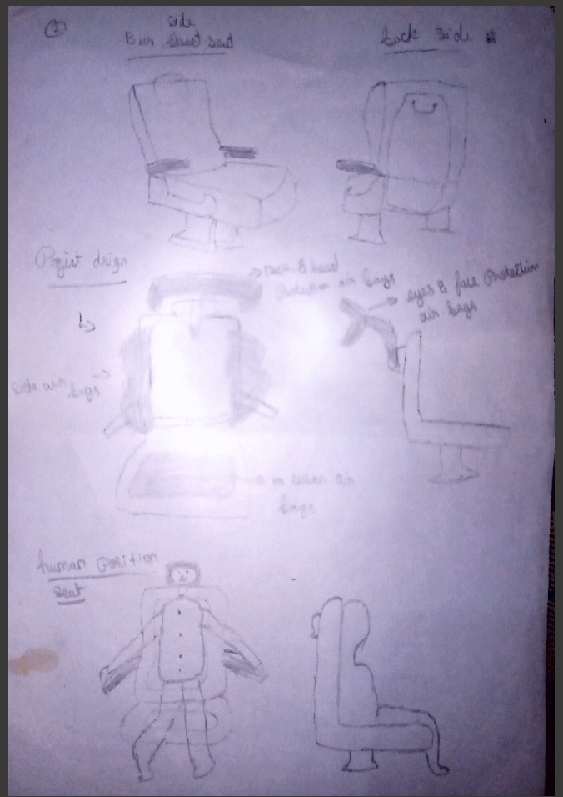
Seat modifying image

Slide 8
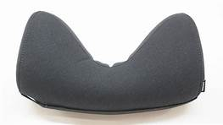
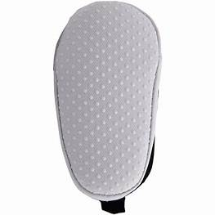
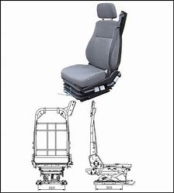
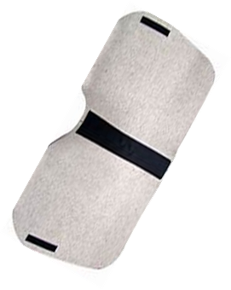
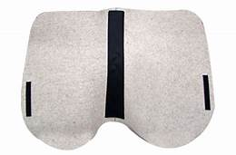
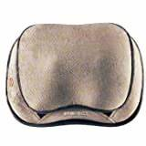
Basic Model

Slide 9

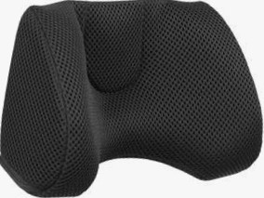


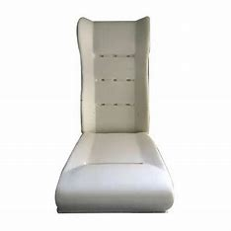
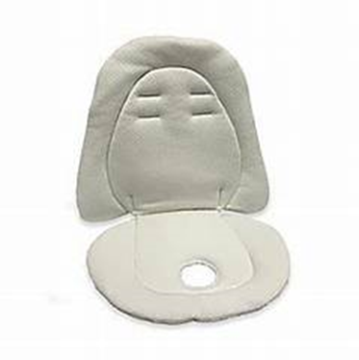
Front model
Head producter
Neck extender
side safety air bags
Air kussen
Normal seat

Slide 10
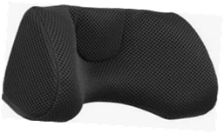
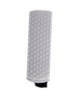
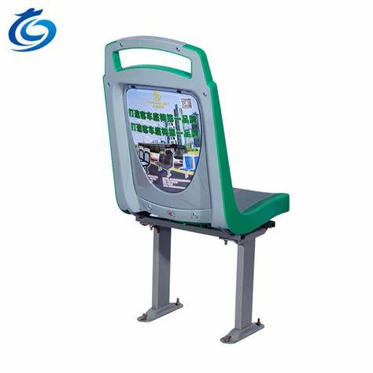
Back model
Face producter
Air cylinder extender
Normal seat

Slide 11
Components
Air cylinder{https://www.newegg.com/smc-cdqmb25-50-test-equipment/p/2YK-0328-00AE9}
Pneumatic Air Tubing Pipe Hose {Buy Generic 10mm OD 6.5mm ID PU Pneumatic Air Tubing Pipe Hose -Blue Online in India at Best Prices (industrybuying.com)}
Air bags
Controller
proximity sensor

Slide 12

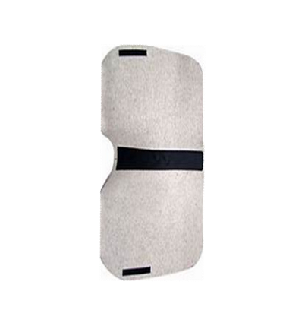
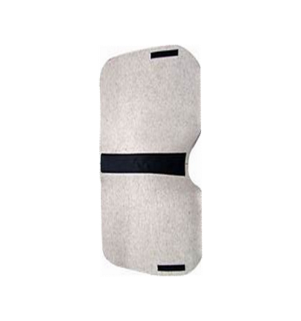
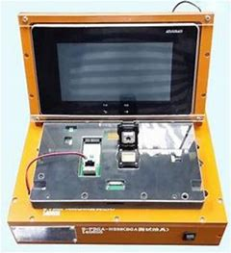
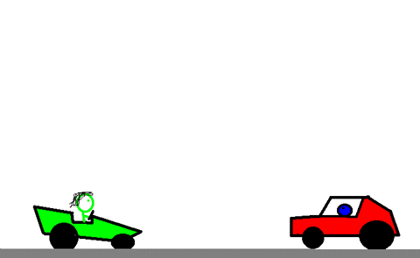
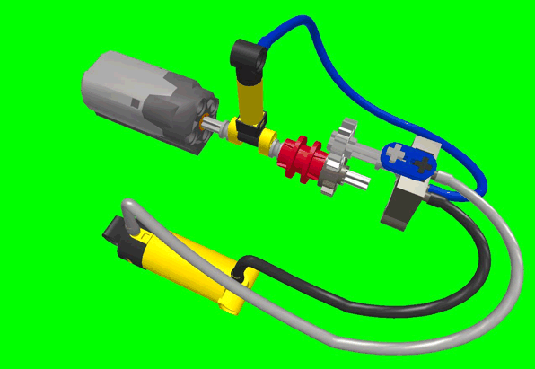
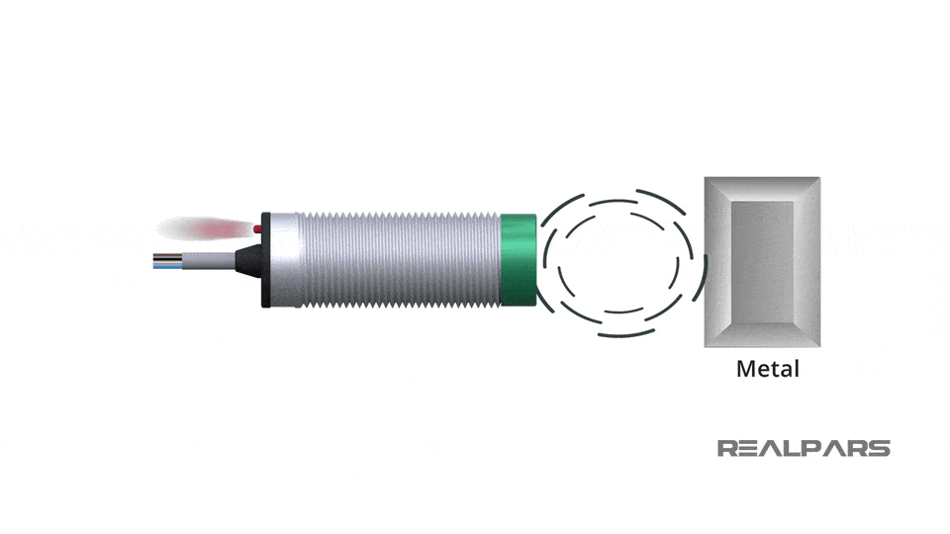
Idea exitising
This has an final stage
This will be used in the bus seat
Step 5
Step 2
Step 4
Step 1
Step 3
They car will be touching the bus or any accient
The sensor sensing the signal, transmitting the controller
The controller has an receiving the sensor signal
Suddenly ON the air cylinder
Air cylinder has an releasing the all side fit the air bags will be fraction of milli secs will be releasing

Slide 13
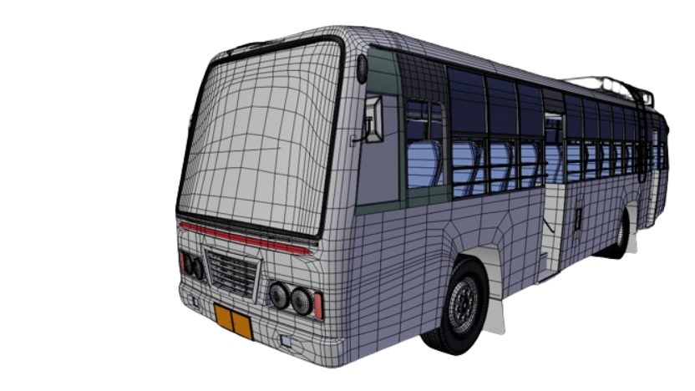
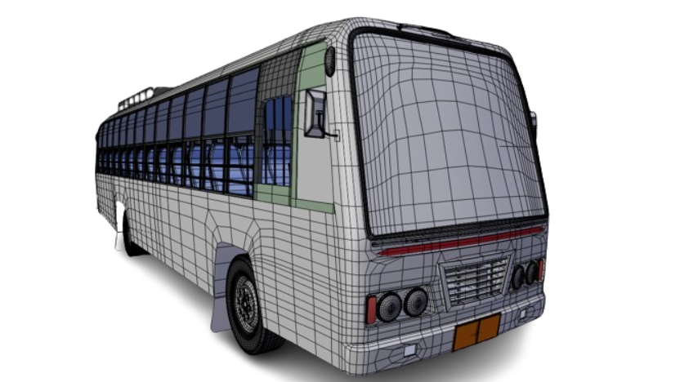
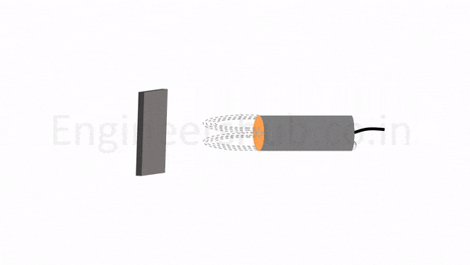
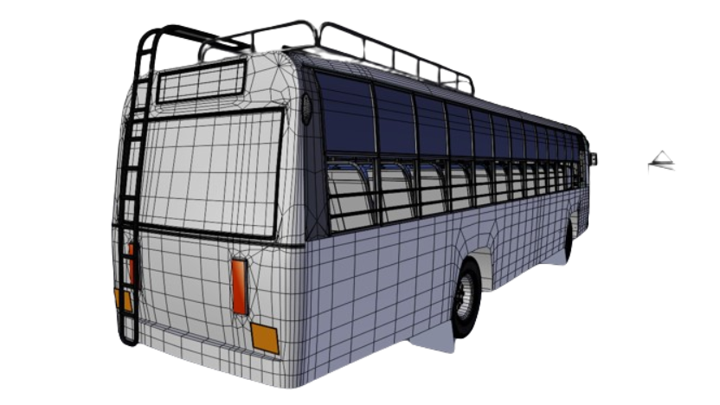
Sensor fixed placed

